Slide 1


Lie Detection using Convolutional Neural Network
SE Dept.
Students:
Vladimir Balagula
Elias Nijim
Supervisor:
Prof. Zeev Volkovich
Date:
11/02/2019

Slide 2
Motivation

Slide 3
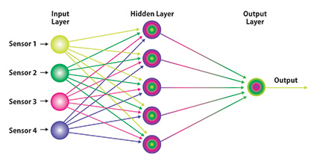
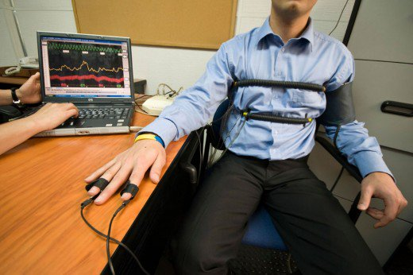
Introduction
Behavioral Sciences
Known Techniques:
Polygraph
Lie detection using Neural network article

Slide 4
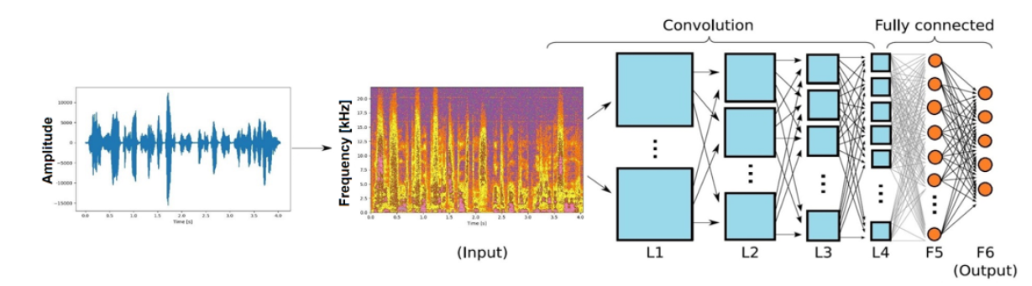
New Approach
In our project, we introduced a new method to recognize a lie. We used a convolutional neural network (CNN). This approach gave us the opportunity to analyze the voice deeper. (…)We believe that this method will give the best result and the CNN will discover the dependency between human voice and lie.

Slide 5

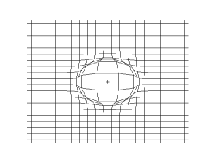
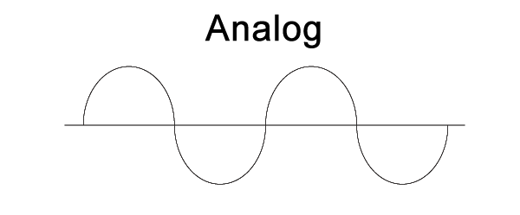
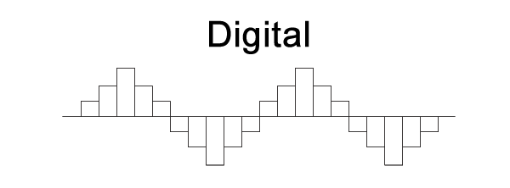
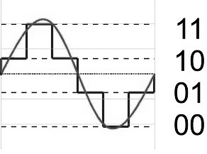


Background
Waves
Longitudinal waves - Sound
Plane pressure pulse wave
Omnidirectional pulse wave on a 2d grid
Analog and Digital signals

Slide 6
Mel-frequency cepstral coefficients (MFCCs)
Mel Frequency Cepstral Coefficient (MFCC) is commonly used in a speech recognition process and in the analyzing speech signal. The pre-step in the speech recognition system is identification of the components of a signal.
Speech
Framing and blocking
Windowing
MFCC coefficients
IFFT
Mel-Scale
FFT

Slide 7
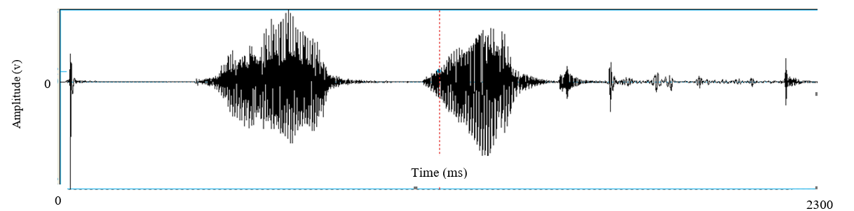
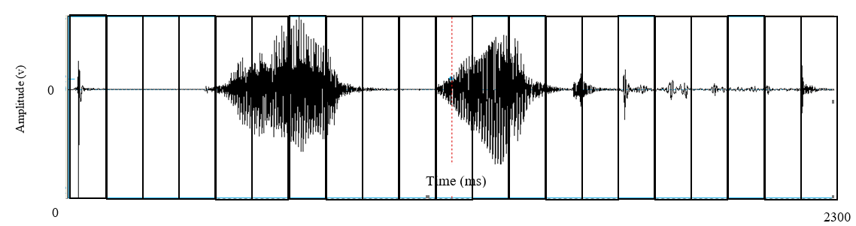
MFCC Algorithm
Framing and blocking

Slide 8
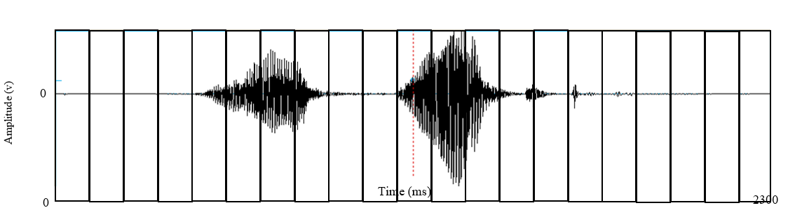
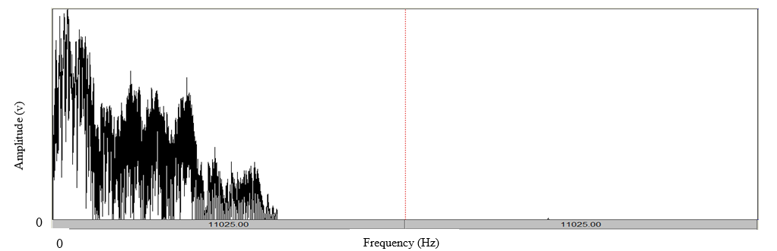
MFCC Algorithm
Windowing ( Hamming window)
FFT
FFT
FFT
FFT
FFT
FFT
FFT
FFT
FFT
FFT
FFT
FFT
FFT
FFT
FFT
FFT
FFT
FFT
FFT
FFT
FFT
Spectrum
Mel-Filters

Slide 9
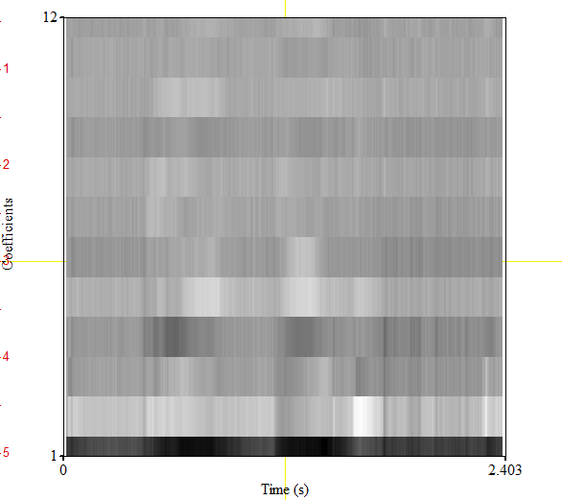
MFCC Algorithm
IFFT

Slide 10

Neural Network
Artificial Neural Network is a mathematical model inspired by biological neural networks that constitute the brain. The main goal of the network is to define dependencies between input data and wanted output at a learning phase. If The model finds the dependence, it gives the desired output on another data.

Slide 11
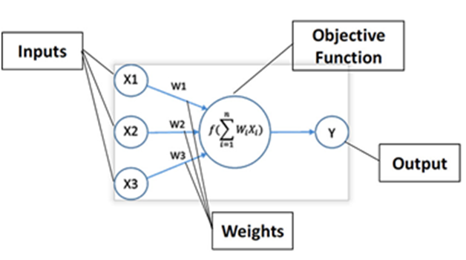
Artificial Neural Network
The model contains neurons, each neuron can communicate with other neurons from different layers. As biological neurons, the Artificial neurons has communication, input and output signals. The output depends on the input from a previous layer, and on the activation function of a particular neuron. Requirements for using NN:
A huge amount of data
Patterns
The main advantage of NN is
ability to learn.

Slide 12

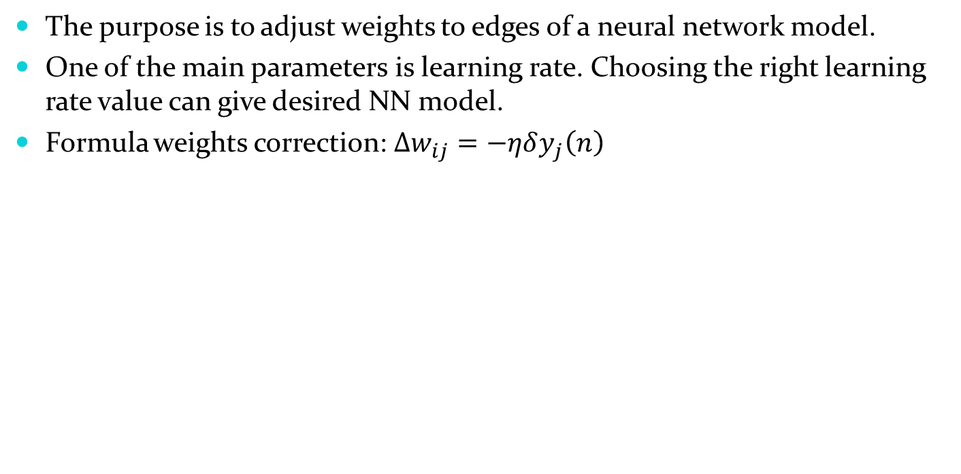
Back-Propagation
The purpose is to adjust weights to edges of a neural network model.
One of the main parameters is learning rate. Choosing the right learning rate value can give desired NN model.
Formula weights correction:$∆w_{ij}=−ηδy_{j}\left(n\right)$

Slide 13
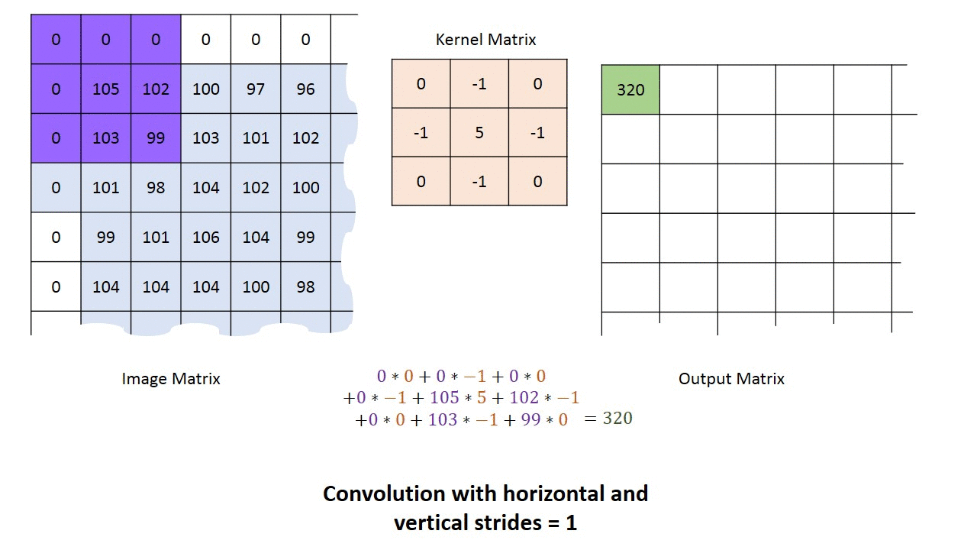
Convolution
Convolution is used to extract important features from data.
Input for convolutional must be a two-dimensional matrix.
Filters – there is a line of filters.
Each filter extract different feature by multiplying the
input in filter matrix.
Convolution applies
different filters and can
run multiple times.

Slide 14
Algorithm
PRAAT – recording the voice using a free software program in format .wav.
Running MFCC on .wav to get Mel-frequency cepstral coefficients.
Using it as input to convolutional layer for extracting different features with 200 filters(5x5) and using this layer 20 times each time with MAXPOOL layer.

Slide 15
Algorithm
In Flatten Layer a two-dimensional matrix is converted into
one-dimensional vector.
Insert feature vector to fully connected layer with rectifier activation function.
The output from hidden layer reaches the Fully connected layer with Softmax activation function and report the user lie probability in the voice

Slide 16
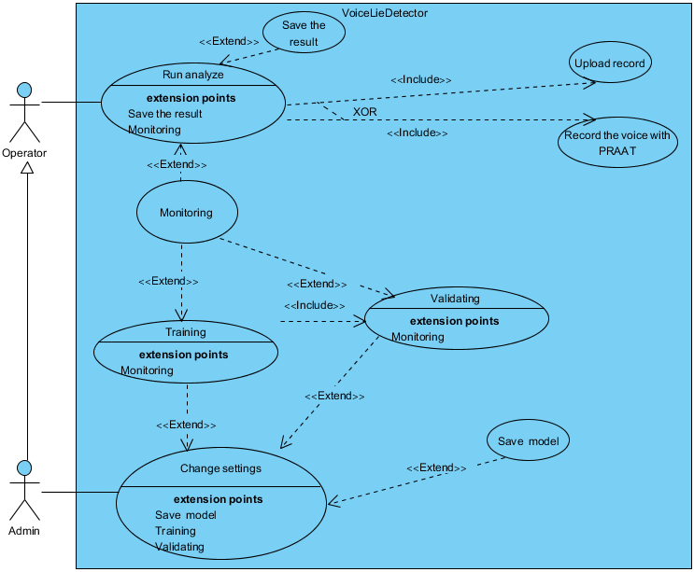
USE CASE

Slide 17
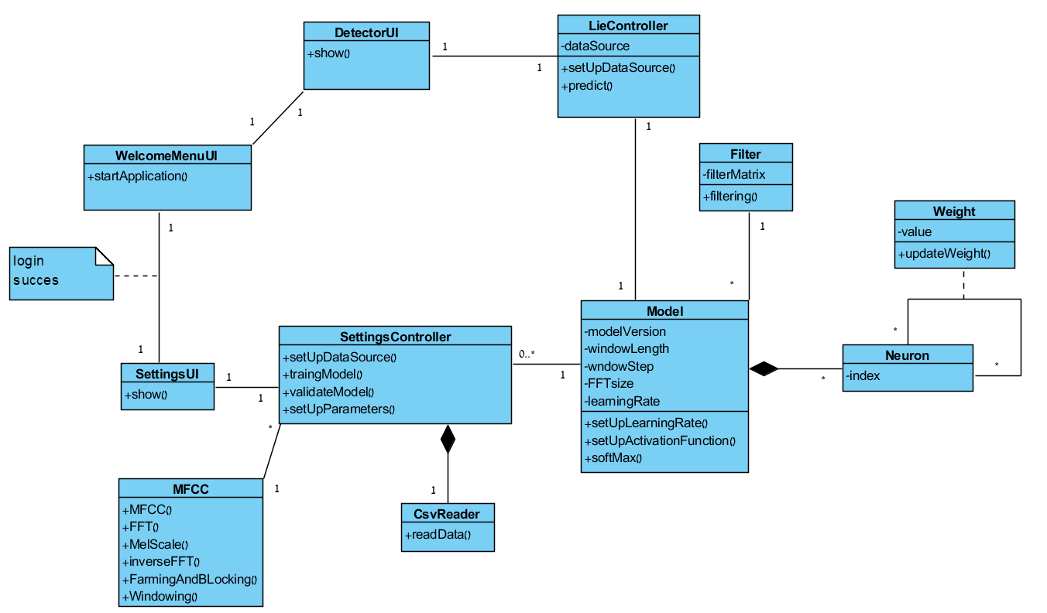
Class Diagram

Slide 18
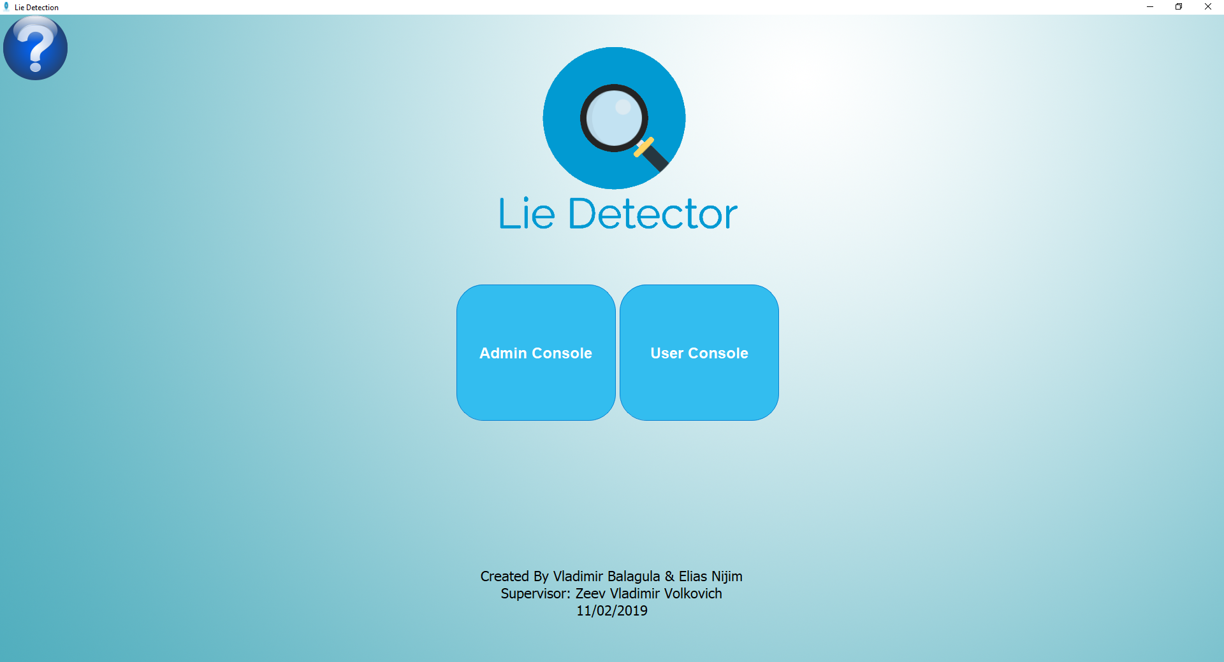
User Interface
Welcome window -
The initial window at start of the program

Slide 19
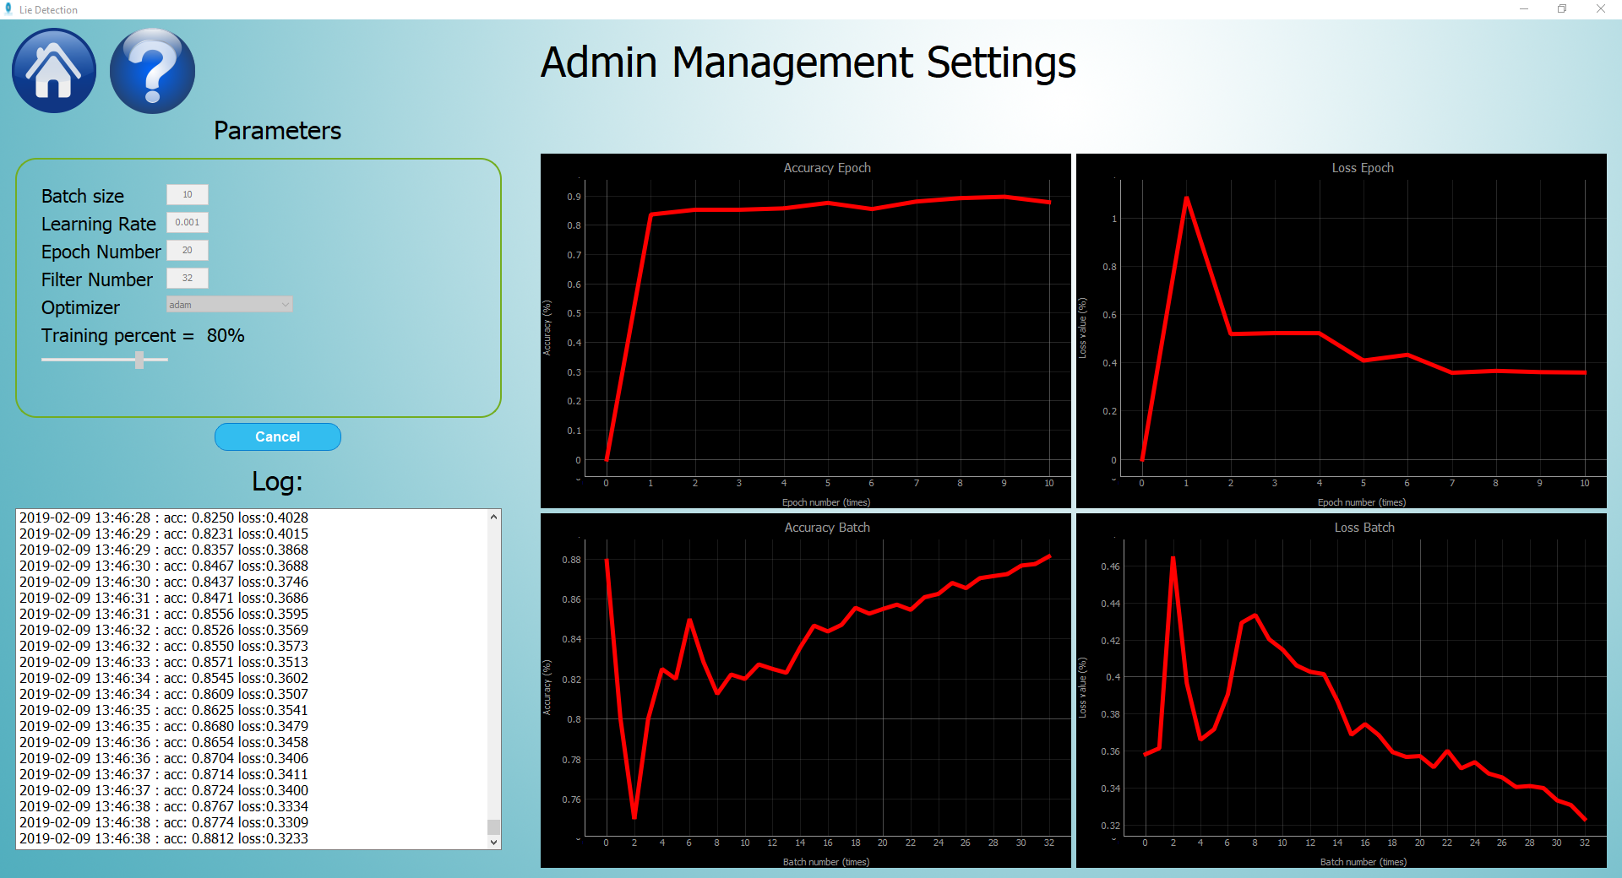
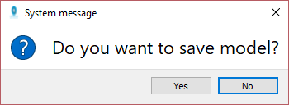
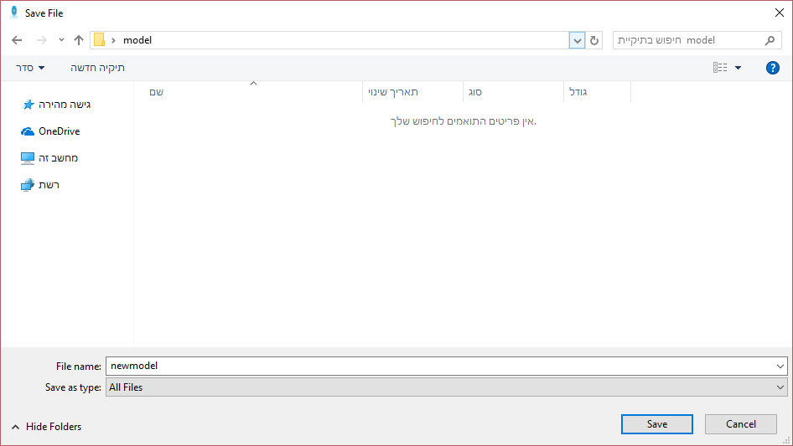
Admin Interface
Save Model Window -
Asking if the admin wants
to store the model
to use it after.
Admin Management Settings –
Giving the opportunity to teach
the model and change the model’s parameters.
Save Model Window -
Saving the model in specific path.

Slide 20
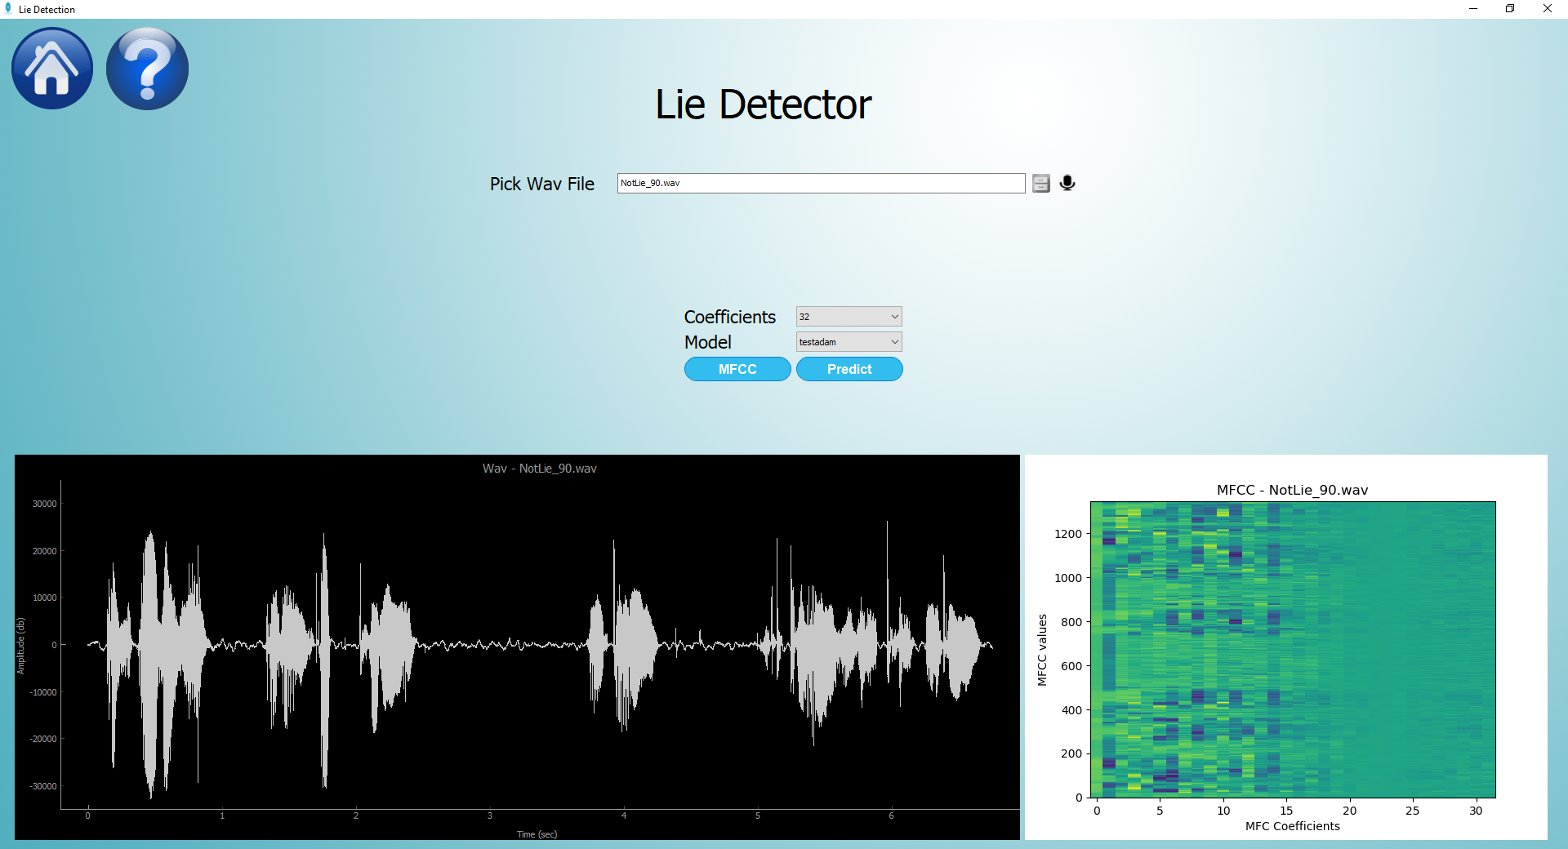
User Interface
User interface – gives the use an option to predict a lie by choosing
data source And Giving the option which data source to use
Sound wave graph
MFCC graph

Slide 21
Testing Plan
Expected result | Test description | Test name
Microphone exist | Validate communication with plugged in microphone. | Communication with microphone
File saved | Validation store permission | Store recorded file
The same values with minimal error | Validate each function in MFCC using the same functions in MATLAB | MFCC validation
Choose top 200 filters | Find filters to give best result for our model | Convolution filters
Display error window | Insert invalid parameters for Model settings | Validation parameters
Display login window | Give only to users with password | Settings open
The same result | Insert the same file twice to the model | Validate model

Slide 22

Expected Result
We expect that applying of the Convolutional Neural Network methodology can lead to a much higher resolution in the speech patterns recognition.

